Slide 1
Revelation 13

Slide 2
Revelation: “Special Clues”
Luke 8:8 (Parable of the Sower)
He who has ears to hear, let him hear . . .
Revelation 2:7, 2:11, 2:17, 2:29, 3:6, 3:13, 3:22
He that has an ear, let him hear what the Spirit saith unto the churches
Revelation 13:9
If any man have an ear, let him hear . . .
Revelation 13:18
Here is wisdom. Let him that has understanding . . .
Revelation 17:9
And here is the mind that has wisdom . . .
Notes:
1. If you have the ability to understand, you better listen up. Because, you are going to be held accountable for what is about to be said.
2. A special clue is about to be given to you.

Slide 3
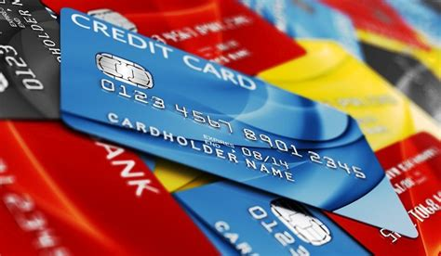
Revelation 13: Topics
Notes:
This chapter deals with historical facts surrounding persecution of Christians in the first century.

Slide 4
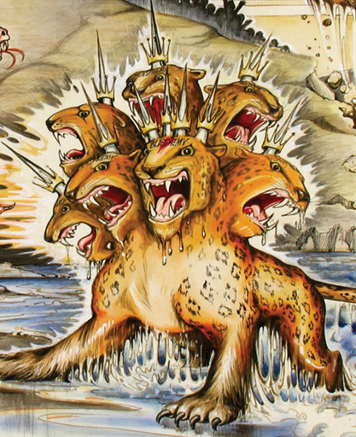
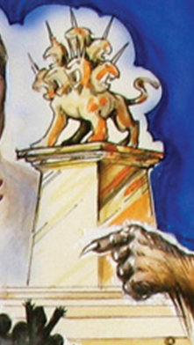
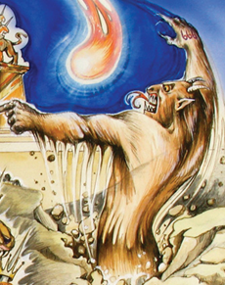
Revelation 13: Solution
Beast #1
Image to Beast
Beast #2

Slide 5
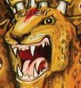

Slide 6
Revelation 13:1-9 - Beast #1
7 heads, 10 horns, 10 crowns
Dragon (Satan) gave Beast:
Power
World throne
Great authority
1 head had fatal wound - healed
World amazed at the Beast
World worshipped Beast
“No one as powerful as Beast”
“No one can war against Beast”
Blasphemed God
Made war against God’s people
Overcame God’s people/world
Evil worshipped the Beast
Its number is a man’s = “666”
Notes:
Head fatal wound healed – explained in Ch. 17
Roman Caesars historically took power by murdering previous Caesar
Nero (who started the persecution in earnest) committed suicide, also
Started persecution in earnest
Senate voted to arrest him and put him on trial for “crimes against nature”
Committed suicide or instructed his closest soldiers to kill him
Still, persecution did not stop – it continued and got worse
Rome leadership appeared to have been imploding, but they survived and grew more powerful
42 months
Roman/Jewish/Jerusalem war 66 AD – 70 AD (@ 3 ½ years)
Verse 5 - Pasted tense!
¹ And I stood upon the sand of the sea, and saw a beast rise up out of the sea, having seven heads and ten horns, and upon his horns ten crowns, and upon his heads the name of blasphemy.
² And the beast which I saw was like unto a leopard, and his feet were as the feet of a bear, and his mouth as the mouth of a lion: and the dragon gave him his power, and his seat, and great authority.
³ And I saw one of his heads as it were wounded to death; and his deadly wound was healed: and all the world wondered after the beast.
⁴ And they worshipped the dragon which gave power unto the beast: and they worshipped the beast, saying, Who is like unto the beast? who is able to make war with him?
⁵ And there was given unto him a mouth speaking great things and blasphemies; and power was given unto him to continue forty and two months.
⁶ And he opened his mouth in blasphemy against God, to blaspheme his name, and his tabernacle, and them that dwell in heaven.
⁷ And it was given unto him to make war with the saints, and to overcome them: and power was given him over all kindreds, and tongues, and nations.
⁸ And all that dwell upon the earth shall worship him, whose names are not written in the book of life of the Lamb slain from the foundation of the world.

Slide 7
Revelation 13: Solution
Beast #1
Image to Beast
Beast #2
Rome led
By Caesar
Notes:
Power of Rome which is in the Caesars
Fatal head wound that is healed

Slide 8
1 head had fatal wound which had healed
Notes:
What could that be referencing?

Slide 9
Revelation 13:1-9 - “Fatal Head Wound”
Augustus
Tiberius
Caligula
Claudius
Nero
Galba
Otho
Vespasian
Titus
Domitian
Used miliary power to kill political enemies
Allegedly murdered by Caligula
Murdered by Praetorian Guard and senators
Poisoned by wife in favor of her son, Nero (?)
Committed suicide (via guards?)
Murdered by Praetorian Guard in coup by Otho
Committed suicide
Died of dysentery
Suspected poisoning by Domitian
Assassination conspiracy: court officials, Nerva
Notes:
Caesars killed each other, but Roman power continued

Slide 11
Revelation 13:1-9 - Beast #2
2 horns
Spoke like Dragon
Same power as Beast #1
Serves Beast #1
World in awe of Beast #2
Created an image to Beast #1”
“Gave life” to image
Enforced worship of Beast #1
“Receiving mark” = certificate
Cert. = bow knee to Caesar
Cannot buy/sell without cert.
Murdered non-kneelers
Seemingly supernatural power

Slide 12
Revelation 13: Solution
Beast #1
Image to Beast
Beast #2
Rome led
By Caesars
Military
and Governors
Notes:
Caesar Worship or Emperor Worship
Domitian required others to address him as “Lord and God”

Slide 14
Revelation 13:14-15 - Image to the Beast
Honors Beast #1
Beast #2 “gave life” to Image
Ordered people to:
Worship Beast #1
Be killed if they refused

Slide 15
Revelation 13: Solution
Beast #1
Image to Beast
Beast #2
Rome led
By Caesars
Law:
Caesar Worship
Military
and Governors

Slide 16
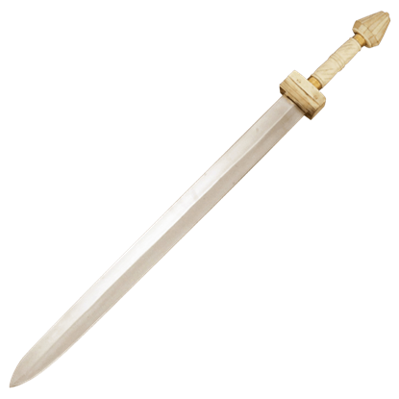
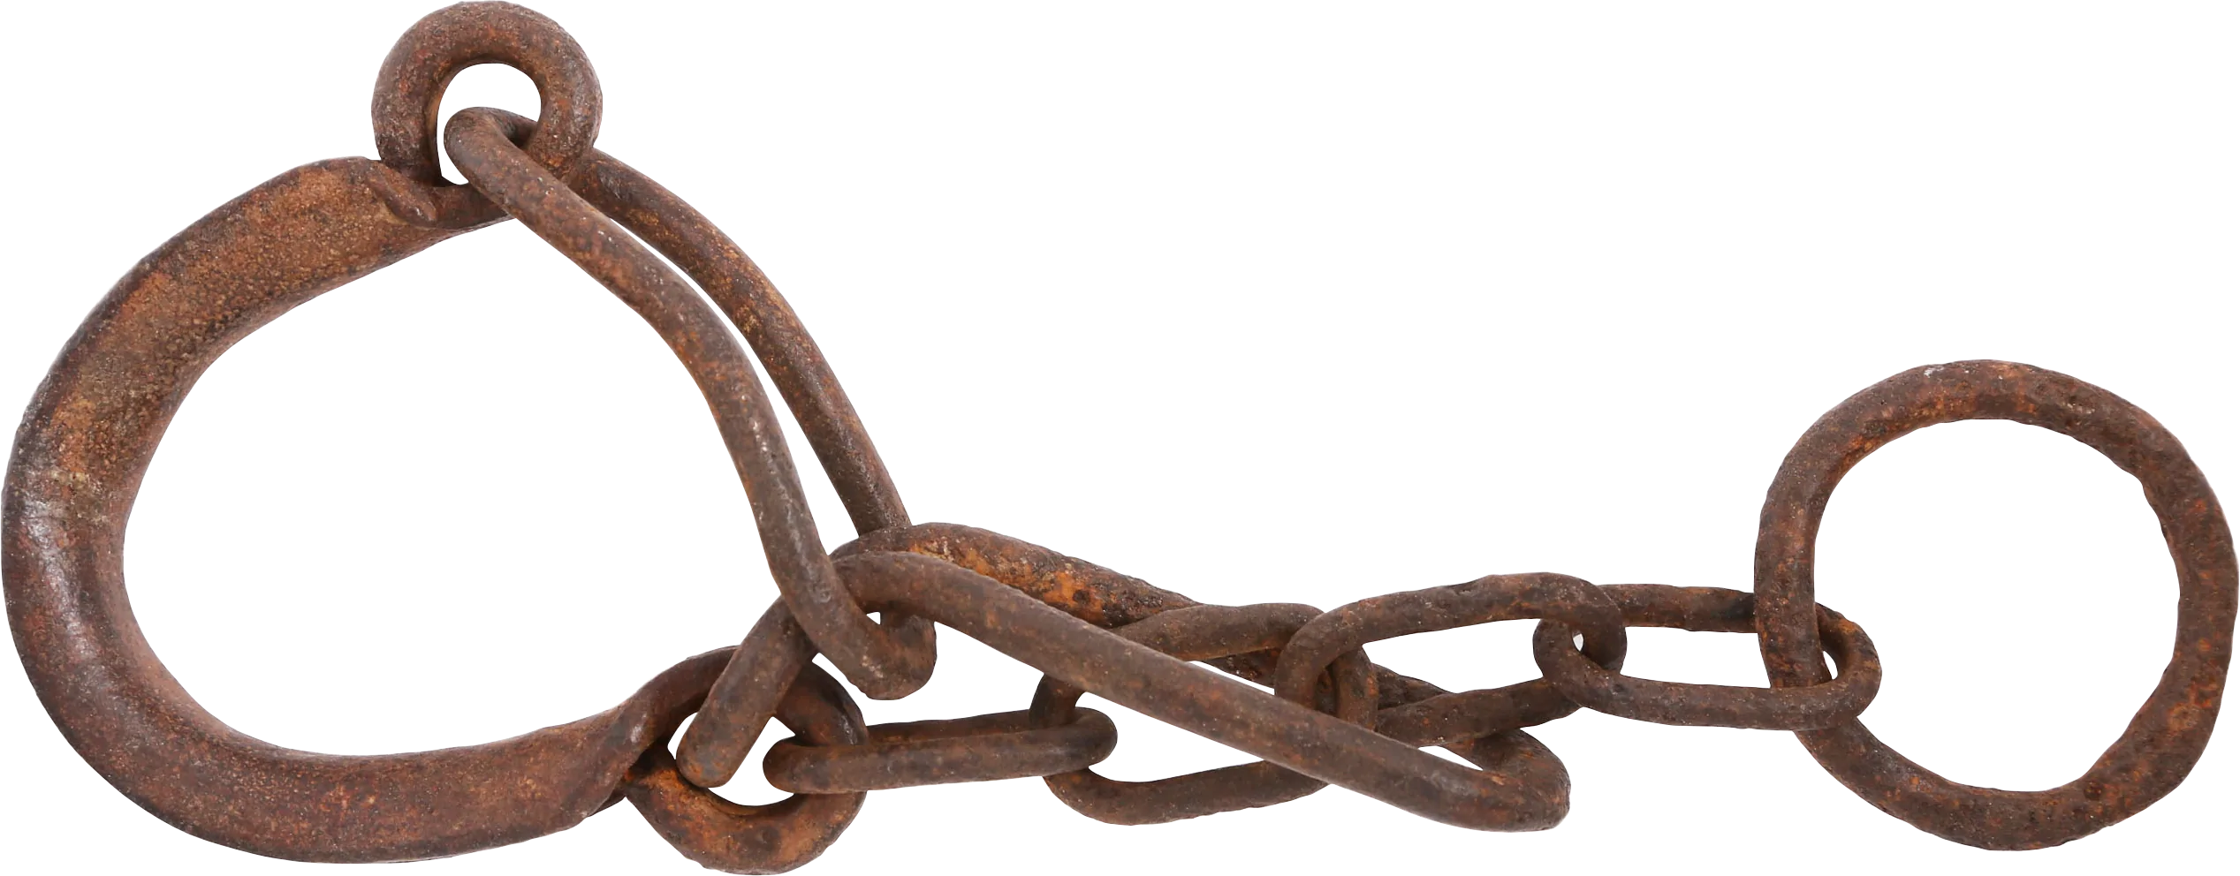
Captivity
and the
Sword

Slide 17
Revelation 13:10 - “Captivity & Sword”
Modern Translations
New International Version
New Living Translation
English Standard Version
Berean Study Bible
New American Standard Bible
NASB 1995
NASB 1977
Amplified Bible
Christian Standard Bible
Holman Christian Standard Bible
Contemporary English Version
Good News Translation
GOD'S WORD® Translation
International Standard Version
NET Bible
Classic Translations
King James Bible
New King James Version
King James 2000 Bible
New Heart English Bible
World English Bible
American King James Version
American Standard Version
A Faithful Version Darby Bible Translation
English Revised Version
Webster's Bible Translation
Early Modern
Bishops' Bible of 1568
Coverdale Bible of 1535
Tyndale Bible of 1526
Literal Standard Version
Berean Literal Bible
Literal Translations
Young's Literal Translation
Smith's Literal Translation
Literal Emphasis Translation
Douay-Rheims Bible
Catholic Public Domain Version
Aramaic Bible in Plain English
Lamsa Bible
Anderson New Testament
Godbey New Testament
Haweis New Testament
Mace New Testament
Weymouth New Testament
Worrell New Testament
Worsley New Testament

Slide 18
Revelation 13:10 - “Captivity & Sword”
King James Version / New King James Version
¹⁰ He that leads into captivity shall go into captivity: he that kills with the sword must be killed with the sword.
Captivity: Perp, Victim
Sword: Perp, Victim
New American Standard Bible
¹⁰ If anyone is destined for captivity, to captivity he goes; if anyone kills with the sword, with the sword he must be killed.
Captivity: Victim, Victim
Sword: Perp, Victim
New International Version
¹⁰ If anyone is to go into captivity, into captivity they will go. If anyone is to be killed with the sword, with the sword they will be killed.
Captivity: Victim, Victim
Sword: Victim, Victim
Notes:
Revelation 13:9
“If any man have an ear, let him hear.”

Slide 19
Revelation 13:10 - “Captivity & Sword”
Biblehub.com Greek Interlinear
¹⁰ If anyone [is to go] into captivity into captivity he goes. If anyone with [the] sword is to be killed it is necessary for him by [the] sword to be killed.
Captivity: Victim, Victim
Sword: Victim, Victim
Zondervan Greek Interlinear
¹⁰ If anyone [is] for captivity, to captivity he goes. If anyone by a sword will kill, it behooves him by a sword to be killed.
Captivity: Victim, Victim
Sword: Perp, Victim

Slide 20
Revelation 13:10 - “Captivity & Sword”
King James Version / New King James Version
Captivity: Perp, Victim
Sword: Perp, Victim
New American Standard Bible
Captivity: Victim, Victim
Sword: Perp, Victim
New International Version
Captivity: Victim, Victim
Sword: Victim, Victim
Biblehub.com Greek Interlinear
Captivity: Victim, Victim
Sword: Victim, Victim
Zondervan Greek Interlinear
Captivity: Victim, Victim
Sword: Perp, Victim
Biblehub.com
Translation Count
Captivity: Perp, Victim - 21 Sword: Perp, Victim - 31
Captivity: Victim, Victim - 24 Sword: Victim, Victim - 14

Slide 21
Revelation: Phobias
Fear of enclosed spaces
“Claustrophobia”
Fear of heights
“Acrophobia”
Fear of spiders
“Arachnophobia”
Fear of “666”
“Hexakosioihexekontahexaphobia”
Notes:
Everyone’s favorite number to put fear in their hearts.
Oral tradition at its worst
Pardon me if covering 666 is an insult to your intelligence.
Is this phobia real???

Slide 22
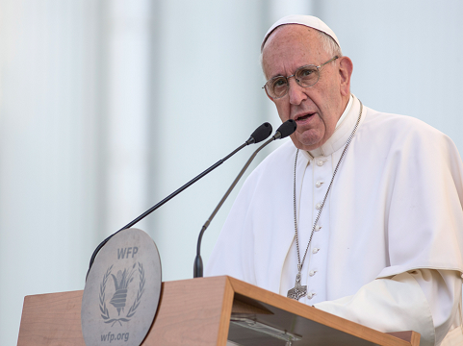
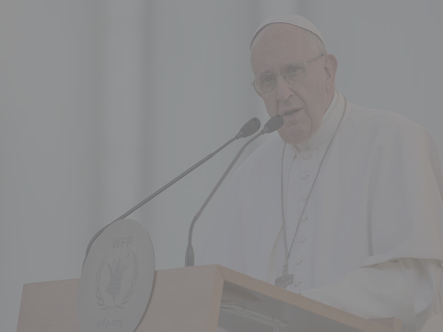
Revelation: Downloads
Revelation: Phobias
22
Argentina’s President Mauricio Macri’s attempt to donate over a million dollars to a charity backed by one of his most famous countrymen - Pope Francis - backfired earlier this week, when the Catholic leader rejected the gift apparently because the amount contained the number 666.
The donation from the South American country to the Scholas Occurentes educational foundation (a worldwide network of schools promoted by Pope Francis) totaled 16,666,000 pesos ($1.2 million), the Guardian reported, citing Italian newspaper La Stampa’s Vatican Insider.
In a note rejecting the donation, the Pope reportedly wrote: “I don’t like the 666,” referring to what is called the “number of the beast” in the New Testament.
“Hexakosioihexekontahexaphobia”
Time Magazine, June 14, 2016
https://time.com/4369505/pope-francis-mauricio-macri-donation-666/
Notes:
Q: Why is this fear alive and well?
A: Ignorance of the scriptures

Slide 23
Revelation 13:18 - “666”
¹⁸ Here is wisdom. Let him that has understanding count the number of the beast: for it is the number of a man; and his number is Six hundred threescore and six.
“Six - Six - Six” does not exist!
ἑξακόσιοι ἑξήκοντα ἕξ ¹
six hundred sixty six
¹ biblehub.com
Notes:
6-6-6 not same as 666.
Why does that matter?
Cannot perform mathematical on 6-6-6
6-6-6 is not a number
666 vs. 616 (“Mark of the Beast”)
Fact: Vulgate “Codex Claromontanus V” Latin Manuscript

Slide 24
Revelation 13 - “666”
What is “666”?
Superstition
“The” Anti-Christ
Sign of end of world
Satan
Hitler, Stalin, Peter the Great
Pope
Political leader (Trump, Obama, Reagan, Bush)
Trinity of sixes
“6” falling short of perfect number “7”
“Trinity of Evil”
Notes:
Who is the “Beast”?
Satan? No, Satan is the dragon
“Trinity of Sixes” = grasping at straws
Contradicts Rev 13:18
These are the games people continue to play with this number.
This is an example of what you get when the churches of Christ as a whole has no idea what it is talking about when discussing topics in Revelation.
Revelation 13:18
Here is wisdom. Let him that hath understanding count the number of the beast: for it is the number of a man; and his number is Six hundred threescore and six.
? What is a rational, reasonable, consistent, intelligent explanation ?

Slide 25
Revelation 13 - Gematria
“Numerology”
The Study of Numbers
“Gematria”
Number Represent Letter
Gematria: Earliest known Jewish use – 78 BC ¹
Coins issued by Hasmonaean king Yannai
Inscription indicating his 25th year of reign
Gematria: Earliest known Greek use – 3rd century BC
System called “isopsephy”
Concept possibly copied later by Hebrews & Arabs ²
Gematria: Earliest documented use – 8th century BC
Assyrian king Sargon II
Wrote numeric value of his name on wall of capital
¹ https://jewishlink.news/features/34381-when-did-we-first-use-gematria
² https://submission.org/what_is_a_numeral.html
Notes:
Isopsephy – “The practice of adding up the numerical values of the letters in a word to form a single number.”
Common in Biblical times to “know your number”.

Slide 26
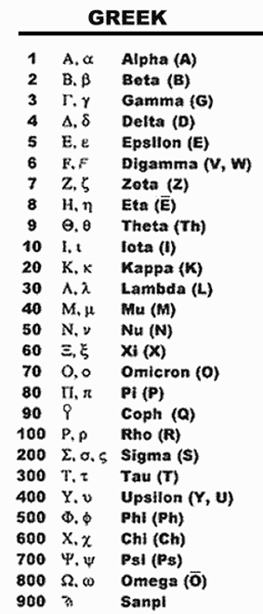
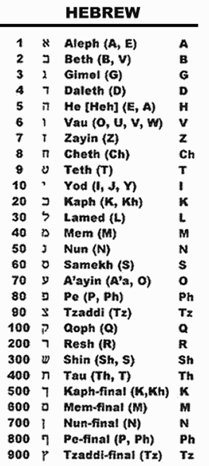
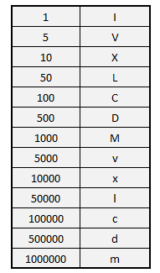
Revelation 13 - Gematria
Roman
Notes:
2nd most common gematria in US
Outlining text book chapters in school
Most used gematria world-wide
OS - Linux, Unix, Windows, Apple
“ASCII” (computers)
American Standard Code for Information Interchange

Slide 27
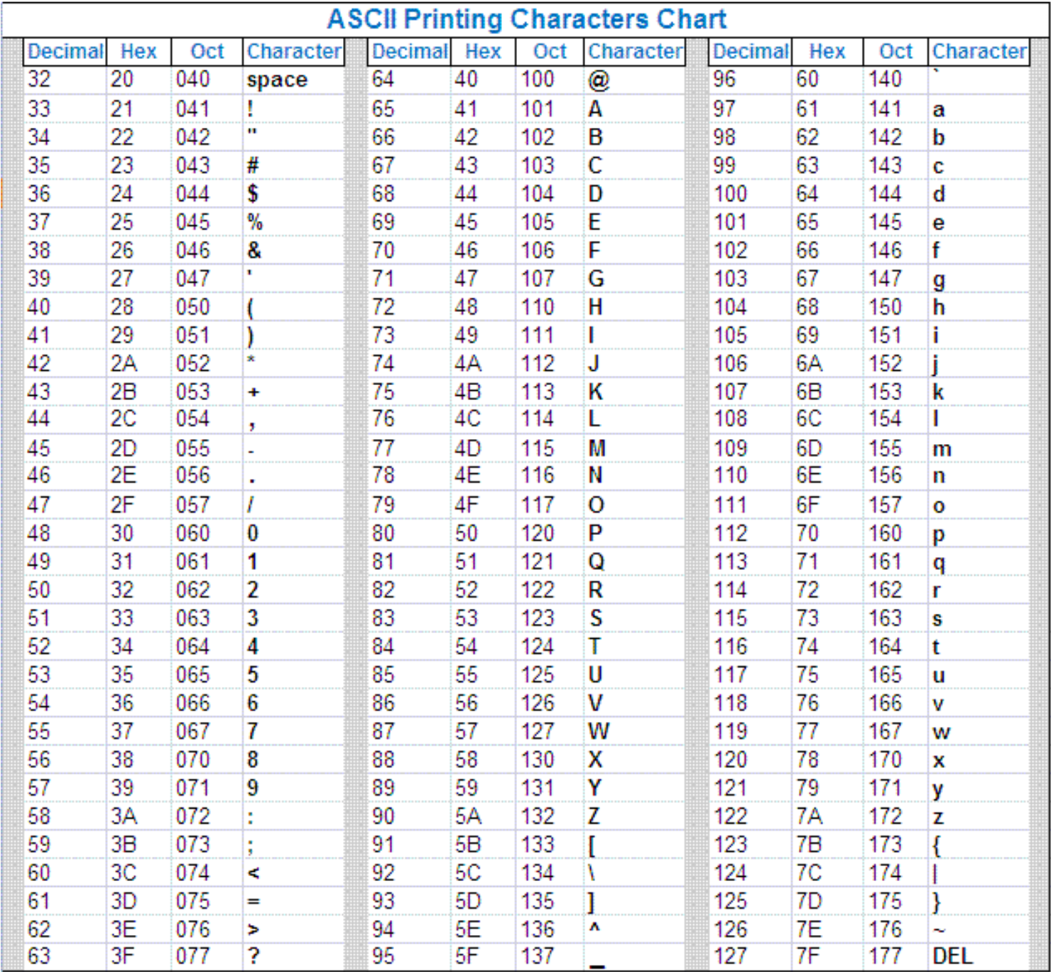
Revelation 13 - Most Common Gematria
Notes:
We cannot live our lives as we do in modern times without gematria.
Pay for food with debit or credit card
Send or receive text on phone
Get on internet
Send or receive Email
Bank calculates interest on your checking or savings account
401K or IRA company calculates its value
Turn on your car’s engine
All processes running in the background on your laptop or phone
Smart TV, refrigerator, dishwasher
Anything with a computer chip

Slide 28
Revelation 13 - “666”
¹⁸ Here is wisdom. Let him that has understanding count the number of the beast: for it is the number of a man; and his number is Six hundred threescore and six.
Dead Sea Scrolls Hebrew spelling
(“Neron Caesar”)
“נירו קיסר”
Transliterated Hebrew (from Latin?) into English
“rsq nwrn”
Notes:
1 option:
Appropriate to assign “666” to Nero?
Yes, he started the first wave of severe persecution of the 1st century church

Slide 29
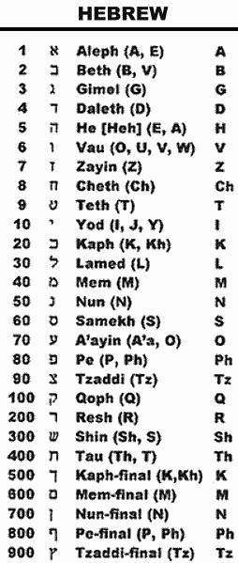
Revelation 13 - “666”
Nun N
Resh R
Waw W
Nun N
Qoph Q
Samech S
Resh R
+ 50
+ 200
+ 6
+ 50
+ 100
+ 60
+ 200
-----
666
Notes:
Does 666 refer to Nero?
Nero was significant character in the persecution of the Christians
Nero started persecution in earnest
No big surprise that this number is his

Slide 30
Revelation 13 - “666”
A designation for the emperor Domitian that sometimes appeared on Greek coins also adds to 666:
an abbreviation for “Autokrator Kaisar Dometianos Sebastos Germanikos” = “Emperor Caesar Domitian Augustus Germanicus”
“Introducing the New Testament:
A Historical, Literary, and Theological Survey”
Mark Allan Powell
Domitian’s official title on Greek coins
“Α ΚΑΙ ΔΟΜΕΤ ΣΕΒ ΓΕ” (Gr)
“A KAI DOMET SEB GE” (En)
https://books.google.com/books?id=B8O5DQkk39YC&printsec=frontcover#v=onepage&q&f=false
Notes:
https://www.reddit.com/r/AcademicBiblical/comments/dkg2l7/are_scholars_in_agreement_that_666_refers_to_nero/
https://books.google.com/books?id=B8O5DQkk39YC&printsec=frontcover#v=onepage&q&f=false
https://books.google.com/books?id=B8O5DQkk39YC&pg=PT739&lpg=PT739&dq=%CE%91+%CE%9A%CE%91%CE%99+%CE%94%CE%9F%CE%9C%CE%95%CE%A4+%CE%A3%CE%95%CE%92+%CE%93%CE%95&source=bl&ots=_I2yIZd0EL&sig=ACfU3U02tyy_bai6ueGHz1bz1aFtD7-A-w&hl=en&sa=X&ved=2ahUKEwilsO3S_sz9AhUxlGoFHTgTBqIQ6AF6BAgnEAM#v=onepage&q=%CE%91%20%CE%9A%CE%91%CE%99%20%CE%94%CE%9F%CE%9C%CE%95%CE%A4%20%CE%A3%CE%95%CE%92%20%CE%93%CE%95&f=false

Slide 31
Revelation 13 - “666”
Domitian’s official title on Gr coins
“Α ΚΑΙ ΔΟΜΕΤ ΣΕΒ ΓΕ” (Gr)
“A KAI DOMET SEB GE” (En)
Αlpha Α
Κapa Κ
Αlpha Α
Ιota Ι
Delta Δ
Οmicron Ο
Μu Μ
1
+ 20
+ 1
+ 10
+ 4
+ 70
+ 40
Εpsilon Ε
Τau Τ
Sigma Σ
Εpsilon Ε
Βeta Β
Gamma Γ
Epsilon Ε
+ 5
+ 300
+ 200
+ 5
+ 2
+ 3
+ 5
-----
666
https://petergoeman.com/the-mark-of-the-beast-666-and-nero-rev-1318/
https://www.reddit.com/r/AcademicBiblical/comments/dkg2l7/are_scholars_in_agreement_that_666_refers_to_nero/
Notes:
BOTH add up to 666??? Only fitting that they both do.
On-line 68 AD’ers deny Domitian persecuted Christians.
On-line 95 AD’ers claim Domitian persecuted Christians more than Nero.
Jerome (Latin Bible translator and historian) 347 – 420 AD
Jerome sets both groups of people straight on history.
“Lives of Illustrious Men”
Section 9. “John the Apostle”
Nero started a 1st wave of persecution
Domitian started a 2nd wave of persecution
“In the fourteenth year then after Nero, Domitian, having raised a second persecution, he [John] was banished to the island of Patmos, and wrote the Apocalypse, on which Justin Martyr and Irenæus afterwards wrote commentaries. But Domitian having been put to death and his acts, on account of his excessive cruelty, having been annulled by the senate, he [John] returned to Ephesus under Pertinax and continuing there until the time of the Emperor Trajan, founded and built churches throughout all Asia, and, worn out by old age, died in the sixty-eighth year after our Lord's passion and was buried near the same city.”

Slide 33
Revelation 13 - “The” Anti-Christ
Αντίχριστος (antichristos) - Ref #500 ¹
“Anti-Christ” 5 times in N.T. ¹
“antichristou” (possessive noun form)
1 John 4:3
“antichristos (noun)
1 John 2:18 (x2)
1 John 2:22
2 John 1:7
¹ biblehub.com
Notes:
“The” Anti-Christ
Not “Another” Anti-Christ
Not “An” Anti-Christ
“The” Anti-Christ
Someone in the future
. . . As if no other antichrists exist
Verses where Greek word for antichrist appears
Not found in Revelation

Slide 34
Revelation 13 - Anti-Christ
1 John 4:3 - And every spirit that confesses not that Jesus Christ is come in the flesh is not of God: and this is that spirit of antichrist, whereof ye have heard that it should come; and even now already is it in the world.
2 John 1:7 - For many deceivers are entered into the world, who confess not that Jesus Christ is come in the flesh. This is a deceiver and an antichrist.
1 John 2:22 - Who is a liar but he that denies that Jesus is the Christ? He is antichrist, that denies the Father and the Son.
1 John 2:18 - Little children, it is the last time: and as ye have heard that antichrist shall come, even now are there many antichrists; whereby we know that it is the last time.

Slide 35
Revelation 13 - “The” Anti-Christ
Anti-Christ (AC) Facts
Anti-Christ
Plurality already here
Denies Jesus is the Christ; Jesus came in flesh
Pre-M never claim this against Beast & “666”
Greek word for Anti-Christ *ONLY* found in 1 & 2 John ¹
Translations comment Anti-Christ parenthetically ¹
Pre-M claim “Beast/666 ‘sounds’ like an Anti-Christ”
No Revelation character assigned as “The” Anti-Christ
Revelation never claims Anti-Christ = Beast = “666”
Bible never claims Anti-Christ nor Beast/666 is end of world
¹ biblehub.com
Notes:
Anti-Christs are already here, and there are a multiplicity of them, not just one that is coming in the future.
Description of Beast #1 and Anti-Christ do not match!
Anti-Christ in 1 and 2 John are not murdering Christians.

Slide 36
Revelation 13:15-17 - Credit Cards
Notes:
Christian businesses were boycotted by Rome.
Anyone doing business with a Christian or a Christian business would be punished and boycotted by Rome as well.

Slide 37
Revelation 13:15-17 - Credit Cards
¹⁵ And he had power to give life unto the image of the beast, that the image of the beast should both speak, and cause that as many as would not worship the image of the beast should be killed.
¹⁶ And he causes all, both small and great, rich and poor, free and bond, to receive a mark in their right hand, or in their foreheads:
¹⁷ And that no man might buy or sell, save he that had the mark, or the name of the beast, or the number of his name.
Notes:
Christian businesses were boycotted by Rome.
Anyone doing business with a Christian or a Christian business would be punished and boycotted by Rome as well.

Slide 38
Revelation 13:15-17 - Credit Cards
“Is a Cashless Society Part of the End Times?”
(Heather Riggleman)
Many view a cashless society as an imminent threat because they believe it will usher in the Antichrist and make it easier for the government to track us and therefore control us - eventually giving the Antichrist the ability to implement the mark of the beast. However, when the Antichrist does come, he will have the power to declare cash as worthless. ¹ He will have the power to require a new form of cash and require individuals to take the mark of the beast and pledge their allegiance in order to acquire this new way of buying and selling goods. But even in a cashless society, there are ways around the system. Bartering will always exist.
¹ https://www.crosswalk.com/special-coverage/end-times/is-a-cashless-society-part-of-the-end-times.html
Notes:
Pre-M claim that the end of world is ushered in by The Antichrist causing Armageddon, defined as kings of the east, Gog and Magog, (i.e. Russia), invading Israel.
That would make Anti-Christ Russian.
This article makes it sound like Anti-Christ is American.
Claims of Pre-M are not even cohesive.

Slide 39
“Is a Cashless Society Part of the End Times?”
(continued)
Revelation 13:15-17 - Credit Cards
“Is a Cashless Society Part of the End Times?”
(continued)
A cashless society will not usher in the Antichrist, nor is it ungodly or antibiblical. Should a cashless society happen, Christians should not fear it. Instead, Christians should have faith in God. Faith and trust that He will provide for all of their needs. Ultimately, we need to remember God is the one who provides our jobs and He is the one who supplies all of our needs. The rapture could occur at any moment.
¹ https://www.crosswalk.com/special-coverage/end-times/is-a-cashless-society-part-of-the-end-times.html
Notes:
Why would Revelation prophesy about America’s usage of credit and debit cards?
Why would 7 churches of Asia care?
7 churches do not even know what America is

